Slide 1

Notes:
Thank you for Downloading our item form Premast.com
-------------------------------
You must attribute the graphics to Premast.com :
In order to use a content or a part of it, you must attribute it to Premast.com,
so we will be able to continue creating new free PowerPoint graphic resources every day.
How to attribute us?
you must credit Premast by keeping the final Credits slide.
"Designed by premast.com"
You are free to use this item:
- For both personal and commercial projects and to modify it.
- In a website or presentation template or as part of your design.
You are not allowed to:
- Sub-license, resell or rent it.
- Include it in any online or offline archive or database.

Slide 2

Urban Play
An Asset Management Platform enriching financial freedom
Urban Play is a platform for Owners & Tenants which helps Owners to manage Tenants easily by sending Reminders, Rental Splits, Paying Rents Online, etc. Tenants can manage their Homes, Get local Services subscribed instantly with one Tap, Pay Bills & Fees with in App.
Also, connect with Service Providers for Services like Milk, Newspaper, Water, Electricity, Telephone, Broadband, Dairy Products & Much More. Service Providers can manage their customers, instantly place orders, connect with ease & also collect payments regularly.
Tenants can browse through Nearby Listed Houses using AR to check Houses remotely for Rent & also place orders from Nearby Shops for Grocery, etc delivered instantly.
The App is connected to Emergency Services like Police, Hospitals, Fire Departments & Municipal Departments which help users in difficult & emergency situations with one Tap.

Slide 3
THE SOLUTION
THE PROBLEM
Owners find Difficulty in managing Tenants
They find difficulty in sending rental reminders, collecting rents, deposits, maintenance, repairs, Violations & Revisions
01
Managing Tenants with Ease
Owners can manage their tenants from the App and send reminders, collect payments, manage complaints & much more.
01
Difficult to Find Genuine Places For Staying
When People shift from a place, they feel difficult in finding places which are genuine, secured & best to stay
02
Renting Homes is Now Easier with Urban Play
We use AR/VR Tech to make it easier for Tenants to search and settle for the house without any inconvenience.
02
Difficult for Service Providers to Find Customers
Finding New Customers / Acquiring Old Customers is a difficult task for Service Providers in an Area
Find Customers & Track with Ease
Owners/Tenants can now avail genuine service providers and also track status & payments.
03
03
Difficulty in Managing Tenants for Owners
Owners find difficulty in managing tenants like asking for rental payments, maintenance and managing complaints, etc
04
Easier Access for Brands & Service Providers
Brands or Service Providers can easily find Customers through App by initiating chat & collect payments on the Go.
04

Slide 4

THE VISION
Our Collective vision is to reach every home by 2025
Every Indian home should contain the logo of Urban Play marked as Urban Play Certified Home
Helping Individuals manage Personal Finances with ease
THE MISSION
To Create a better experience with technical solutions for people who’re facing problems in personal finance management and real estate management

Slide 5
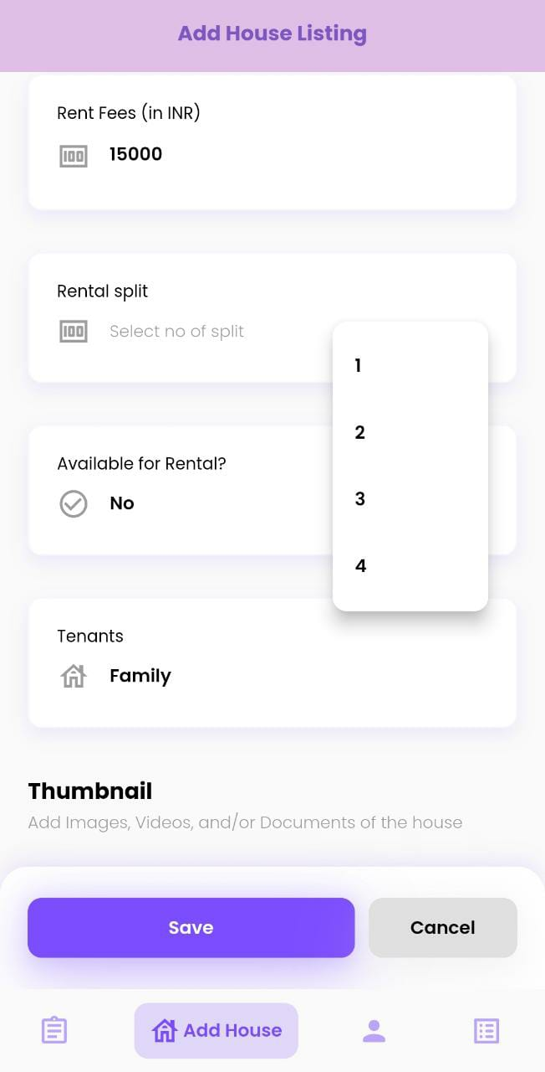
CurrentFeatures
Owners can manage their house on the App and allot it to Tenants (if occupied)
Owners can send Rental Reminders to Tenants via WhatsApp and SMS.
Owners can now collect Rental Payments from Tenants allowing them to pay at their convenience.
Owners can allow Tenant to pay Rent in Installments.
Tenants can choose any Payment Mode to Pay the Rent (Credit Card, EMIs, PayLaters, Wallets, Debit Cards, UPI & Netbanking).
Introducing Rental Split, It allows Tenant to pay Rent in Splits upto 4 times in a Month.
Tenant can choose the dates and pay the amount in equal parts for the current month (eg -02nd, 11th, 21st, 28th are the split dates)

Slide 6
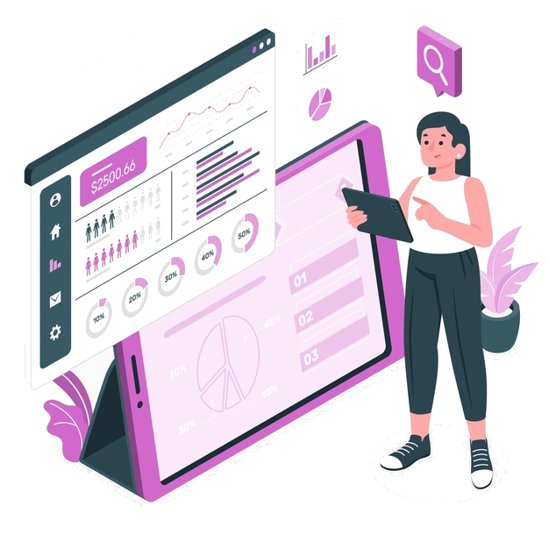
MARKET VALIDATION
On an Average
On an Average
100+
15000+
Houses built a Day
Spent on Biils, Rents
Monthly Occupancy Rate
Making Services accessible easily for homes
85%
in every city

Slide 7
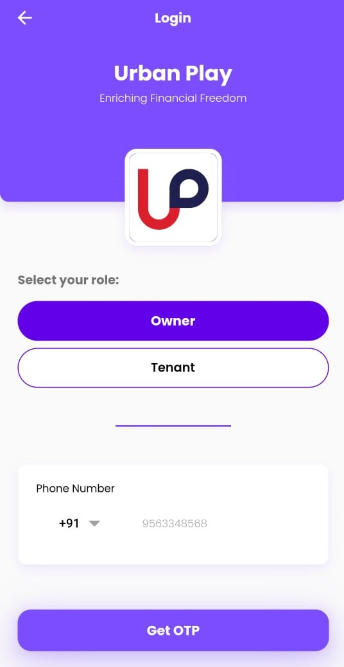
OUR PRODUCT
Urban Play is an asset management platform connecting the community in providing better services to users (Tenants, Owners, Service Providers & Brands).
Owners can manage tenants, get payments easily. Service Providers can connect with the users & provide services and also get payments regularly.
Brands can directly reach out to users on platform to engage & built appropriate audience to make new customers
01
Manage Tenants
Owners can Add Tenants & Manage them for sending reminders, collecting payments & also managing complaints.
02
Find Homes & Build Relations with Owners
In Today’s world, people prefer trusted & secured place to live & With Urban Play, people can easily find homes & build tenantship with Owners with ease.
03
Find Service Providers & Connect Instantly
No need to look on Google or ask neighbours for best service providers in the area. Urban Play leverages all the data at one place and a on the Go option to connect with them .

Slide 8
Business Model
KEY PARTNERS
Real Estate Builders
Property Experts
Legal Partners
Service Providers
Brokers
Brands
KEY ACTIVITIES
KEY RESOURCES
CUSTOMER SEGMENTS
Manage Property Listing & Notifications
User Management - Owners, Tenants, Providers, Brands
Manage Ads & Payments
Mobile App & Web App to Manage all Services
Marketing & Sales Team
Owners
Tenants
Small Service Vendors
CHANNELS
Website
Mobile App
Advertisements
VALUE PROPOSITIONS
CUSTOMER RELATIONS
COST STRUCTURE
App Notifier
App Newsletter
Social Media
24x7 Support
Feedback & Reviews
Connecting Owners with Tenants
Notifying Users with nearby Rental Spaces
Convenience in Subscribing Services
Ease of Paying to Owners & Services
Technology Costs - Web & Mobile App Development
Marketing Costs - Branding & User Acquisitions
Human Resources Cost - Hiring & Managing Team
REVENUE STREAMS
Property Listing Fees
Subscription Models
Exclusive Brokerage Rates
Advertisement Revenues
Commission on Payments Made

Slide 9

REVENUE MODEL
Subscription Model
Advertising Fees
Payment Fees
We have few set of features integrated in free plan.
We plan to bring 3 More plans - Pro, Premium & Platinum for many other options for Users.
Pro - 199/Mo ; Premium - 599/Mo ; Platinum - 1099/Mo
We charge nominal fees from Brands for Advertising on App for selling their services directly for consumers.
We shall charge minimal transaction fees on App that ranges from 2% on the transaction for Service Providers..
Exclusive Brokerage Rates
We plan to offer 2 Plans - EBR & BR.
EBR - 15% will be charged as a platform commission fee
BR - 20% will be charged as a commission fee.

Slide 10

Financial Expectations
Seed
1 Crore+
Initial Funding
Investing on Acquiring User Growth, Hiring Full Time Employees and applying different strategies on the App

Slide 11

Strategy & Fund Utilization
Marketing
Human Resource
Partnerships
Technology
Our Main focus is on Marketing as we need to acquire users like Owners, Community Heads, Tenants, Brands & Service Providers.
So, 45% of overall investment will be utilized upon the Marketing side to acquire users & also establish Brand.
To scale up, we need People who are required to manage Operations, Technology, Finance in the Company. We utilize 25-30% of the total investment on to the team.
We shall collaborate or partner with companies who are working in the same domain which eliminates the competition and focus on market sustainability.
Introducing new features or ideas to users happen with a great design & effort made with latest technology tools. We utilize 25-30% of the investment on Technology resources & tools.

Slide 12
Marketing Strategies
Campus Ambassadors
Connected with Campuses to promote Urban Play to create awareness to the Students about Urban Play App
Advertising
Running different google ads campaigns for Urban Play
Influential Campaigns
We’re connecting with Influencers from different social media platforms to run challenging campaigns around the network
Referral Marketing
Hosting a referral campaign for the current users to on-board other users via referral to win special prizes

Slide 13

OUR ADVANTAGES
Design & Brand
Branding matters most for the Users to trust the App with Ease, Second most is User Interface which is simple yet attractive to use
First to Market #1
There is no competition in the Market & we stand out the first to bring an automated end to end platform for the Community
Get Incentives
Users can earn rewards for using the App & performing various activities like paying bills, subscribing to services & many more.
One App. One Solution..
No need to use different apps for different things. Users can now pay rents, bills, fees & much more in one App with single tap
Genuine Services on the Go
Users can get genuine & secured services verified by Urban Play from Service providers by connecting with ease on App

Slide 14

OUR TESTIMONIALS
Rental Split is amazing feature. Loving It
Nice App. Keep updating
Rental Reminders are Flawless
Great Work. Keep updating the App
for Masses out there

Slide 15
Download App/ Visit Website
https://urbanplay.in

Slide 16
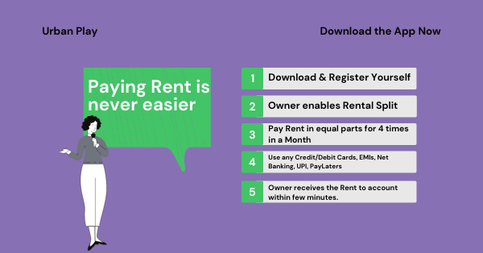
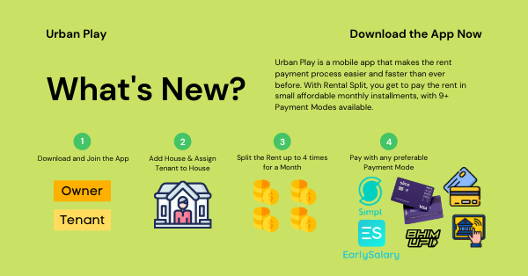
THANK YOU
— Team
Urban Play

